Slide 1




Are warming temperatures accelerating fish growth? A case study of Common sole in North East Atlantic waters
Kelly Diaz

Slide 2

Work Plan
August - September: otolith photo taking
October - December: measuring otoliths + gather additional data (temperature and fishing pressure) + literature review
January: measuring otoliths + literature review corrections
February: data analysis + writing
March: discussion writing
April: first draft
May: corrections
Notes:
Fishing pressure: ICES
Temperature: ISIMIP (The Inter-Sectoral Impact Model Intercomparison Project) or HADISST (Hadley Centre Global Sea Ice and Sea Surface Temperature)

Slide 3
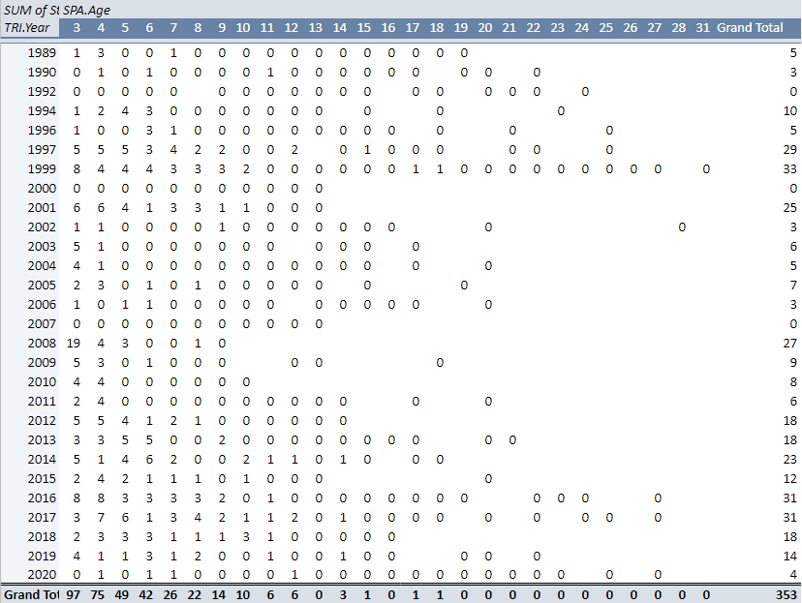
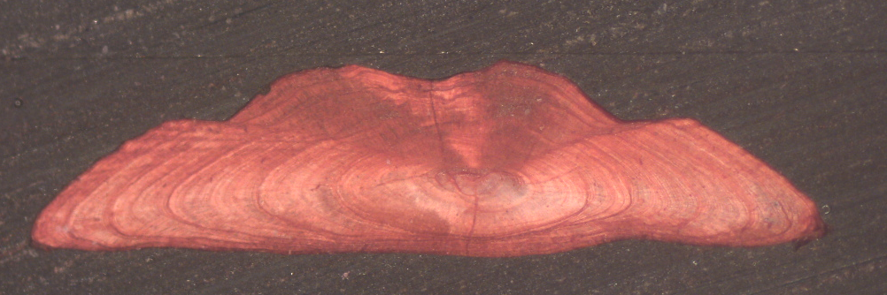
Total Pictures taken
ILVO otoliths: From ~6500 otoliths analyzed, 353 chosen, if
Not broken
Clear shape of nuclei
Clearly readable rings
Age read matches age declared in database
IFREMER otoliths: 2012 - 2017

Slide 4
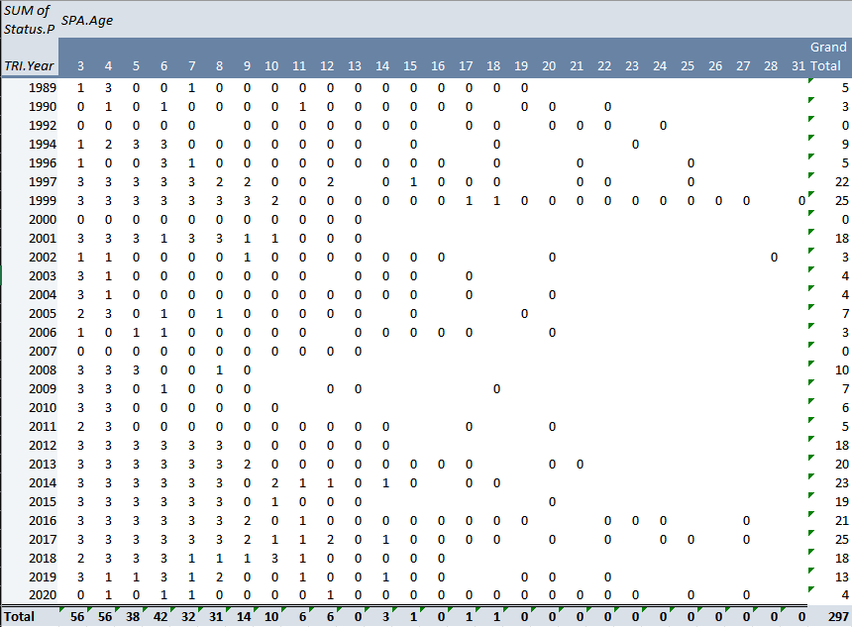
Total Measurements taken (approximation)
Measurements are taken:
3 replicas per age category
Clear shape of nuclei
Clearly readable rings
IFREMER otoliths: 2012 – 2017
Total approximate ~300. Ages mostly =<10 years old

Slide 5
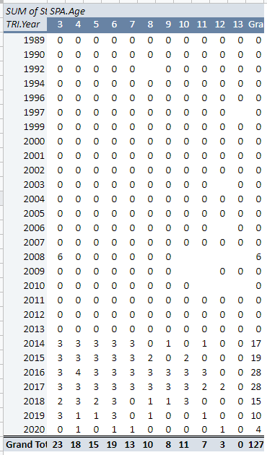
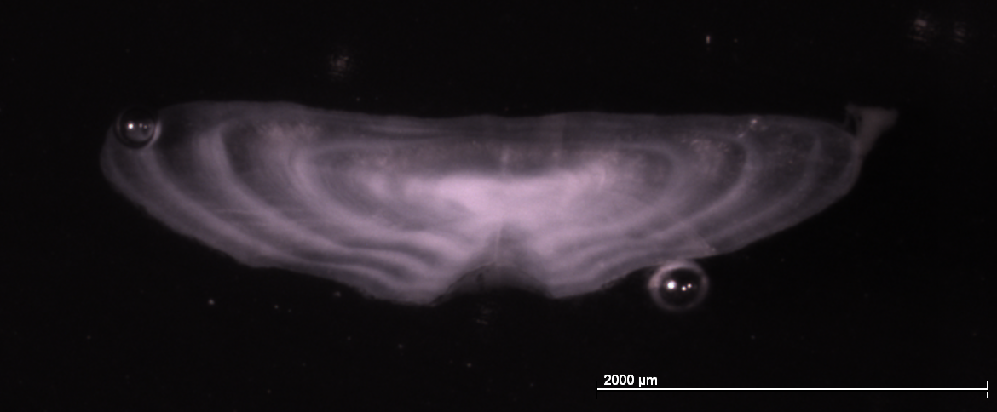
Current Total Measurements
ILVO otoliths and IFREMER otoliths (2012 – 2017)
Ages mostly <12 years old

Slide 6
Current steps:
Literature Review: 13 February 2023
Share GitHub
Notes:
Tools/ methodology/type of work that is planned
Find the linear regression formula

